Slide 1
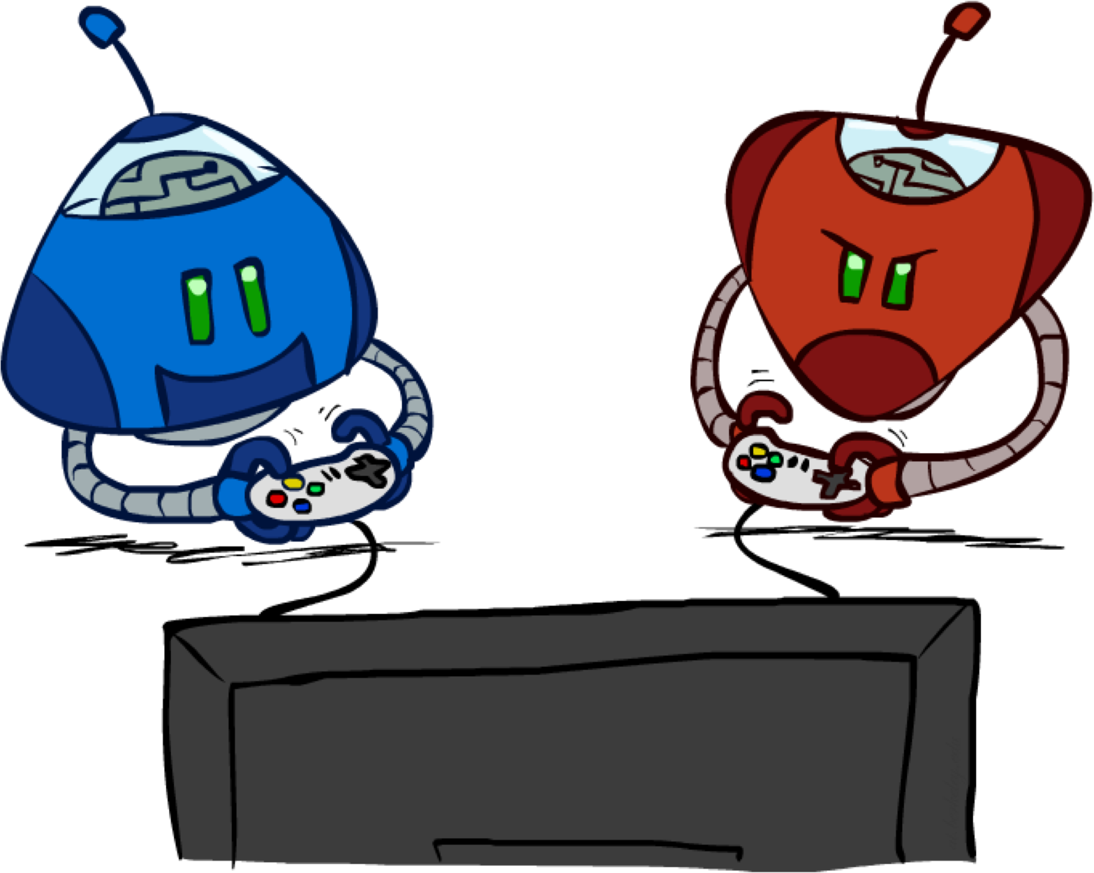
CMPT310: Artificial Intelligence
Local Search + Games
[These slides adapted from Stuart Russell and Dawn Song, and Angela Liu and Yanlai Yang]

Slide 2
Iterative Algorithms for CSPs
Local search methods typically work with “complete” states, i.e., all variables assigned
To apply to CSPs:
Take an assignment with unsatisfied constraints
Operators reassign variable values
No frontiers! Live on the edge.
Algorithm: While not solved,
Variable selection: randomly select any conflicted variable
Value selection: min-conflicts heuristic:
Choose a value that violates the fewest constraints
I.e., hill climb with h(n) = total number of violated constraints

Slide 3
Example: 4-Queens using minConflict Algo
States: 4 queens in 4 columns (4⁴ = 256 states)
Operators: move queen in column
Goal test: no attacks
Evaluation: c(n) = number of attacks
[Demo: coloring – iterative improvement]
Notes:
L5D1 – python demos
Coloring – javascript demos

Slide 4
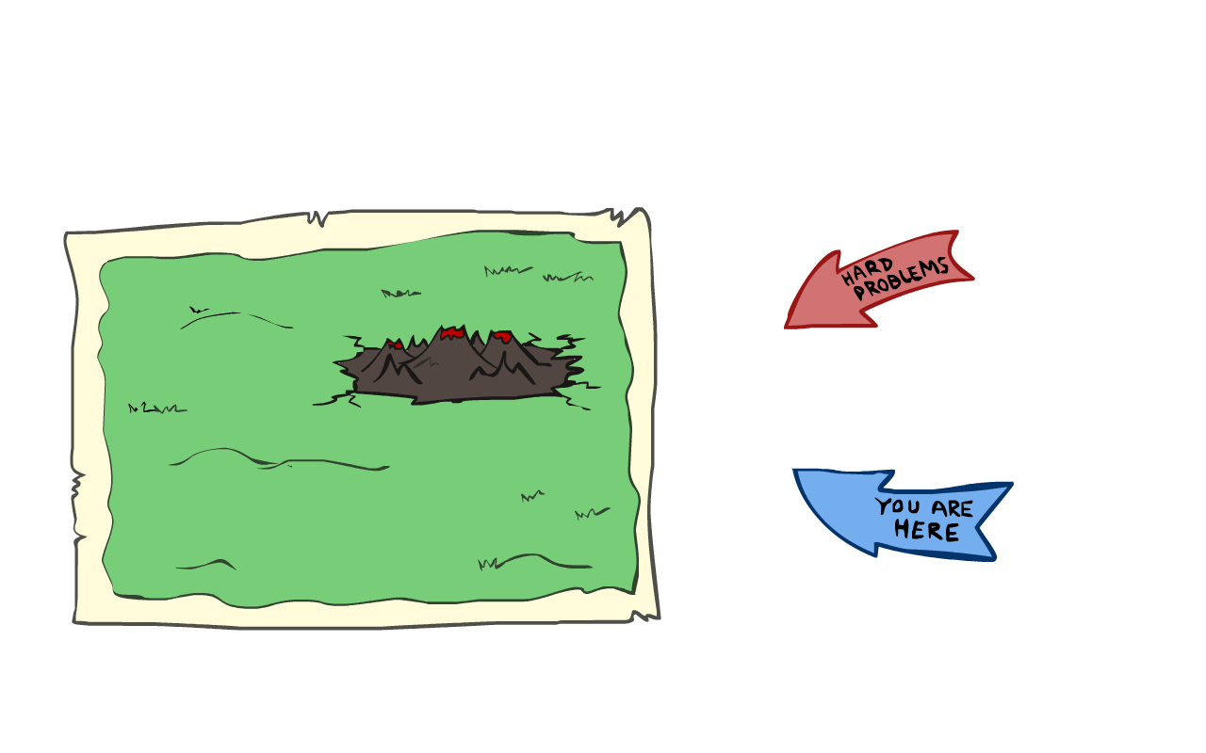
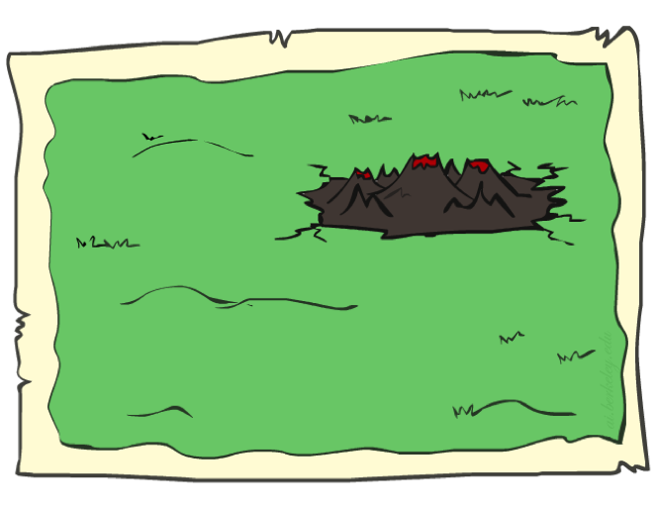
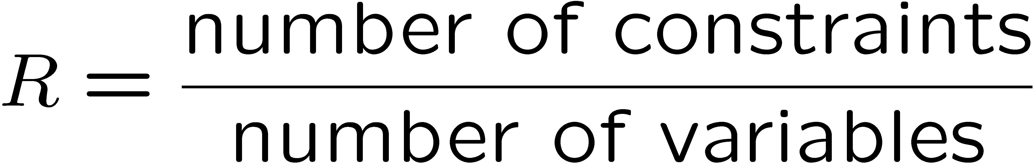
Performance of Min-Conflicts
Given random initial state, can solve n-queens in almost constant time for arbitrary n with high probability (e.g., n = 10,000,000)!
The same appears to be true for any randomly-generated CSP except in a narrow range of the ratio

Slide 5
Local Search
Tree/Graph search keeps unexplored alternatives on the frontier (ensures completeness)
Local search: improve a single option until you can’t make it better (no frontier!)
New successor function: local changes
Much faster and more memory efficient (but incomplete and suboptimal)

Slide 6
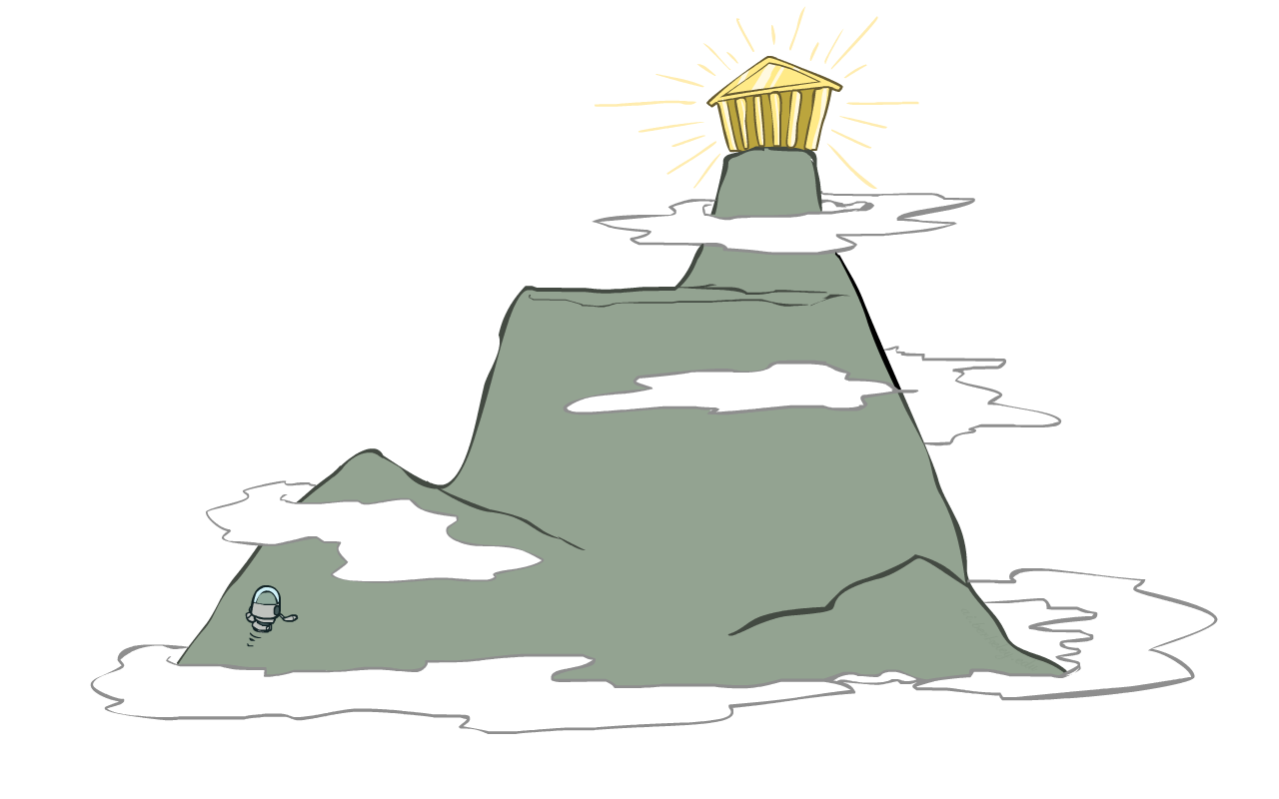
Hill Climbing
Simple, general idea:
Start wherever
Repeat: move to the best neighboring state
If no neighbors better than current, quit
What’s bad about this approach?
Complete?
Optimal?
What’s good about it?

Slide 7
Hill Climbing Diagram

Slide 8
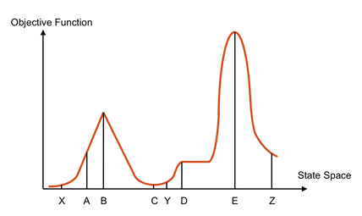
Hill Climbing Quiz
Starting from X, where do you end up ?
Starting from Y, where do you end up ?
Starting from Z, where do you end up ?

Slide 9
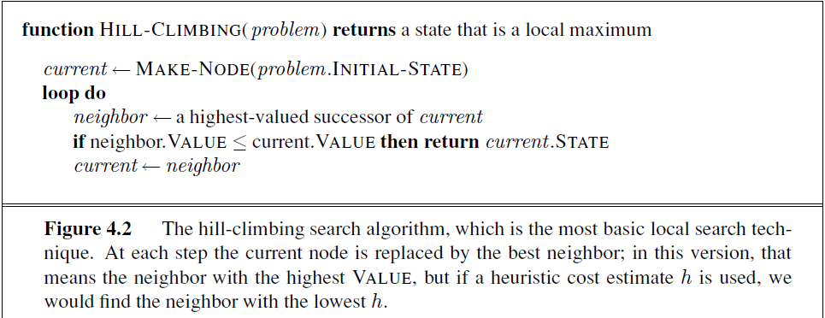
Hill Climbing Algorithm

Slide 10
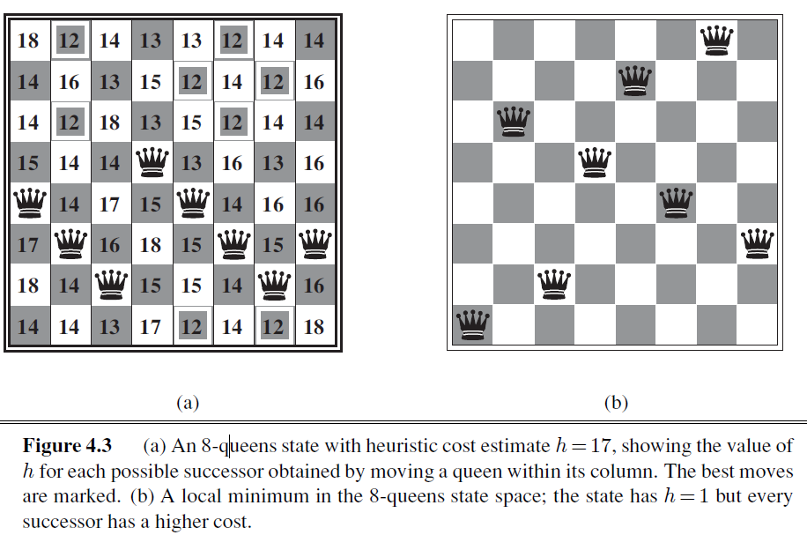
Example: 8Queens solution with Hill Climbing
Starting from a complete state (all 8 queens randomly assigned)

Slide 11


Local Search in Continuous Space Example: Siting airports in Romania
Place 3 airports to minimize the sum of squared distances from each city to its nearest airport
Oradea
Airport locations
x = (x₁,y₁), (x₂,y₂), (x₃,y₃)
71
Neamt
Zerind
151
87
75
City locations (x_{c},y_{c})
C_{a} = cities closest to airport a
Objective: minimize
Iasi
Arad
140
Sibiu
92
99
Fagaras
118
Vaslui
80
Timisoara
Rimnicu Vilcea
142
f(x) = Ι:_{a} Ι:_{cΕC} (x_{a} - x_{c})² + (y_{a} - y_{c})²
111
Lugoj
Pitesti
211
a
97
70
98
Hirsova
Mehadia
146
101
85
Urziceni
75
Drobeta
138
86
Bucharest
120
90
Giurgiu
Craiova
Eforie

Slide 12
Handling a continuous state/action space
Discretize it!
Define a grid with increment 8 , use any of the discrete algorithms
Choose random perturbations to the state
First-choice hill-climbing: keep trying until something improves the state
Simulated annealing
3. Compute gradient of f(x) analytically

Slide 13
Finding extrema in continuous space
Gradient vector ςf(x) = (ςf/ςx₁, ςf/ςy₁, ςf/ςx₂, …)^{T}
For the airports, f(x) = Λ_{a} Λ_{cΕCa} (x_{a} - x_{c})² + (y_{a} - y_{c})²
ςf/ςx₁ = Λ_{cΕC1} 2(x₁ - x_{c})
At an extremum, ςf(x) = 0
Can sometimes solve in closed form: x₁ = (Λ_{cΕC1} x_{c})/|C₁|
Is this a local or global minimum of f?
Gradient descent: x ¬ x - αςf(x)
Huge range of algorithms for finding extrema using gradients

Slide 14
Summary
Many configuration and optimization problems can be formulated as local search
General families of algorithms:
Hill-climbing, continuous optimization
Genetic algorithms: break and recombine states
Many machine learning algorithms are local searches

Slide 15
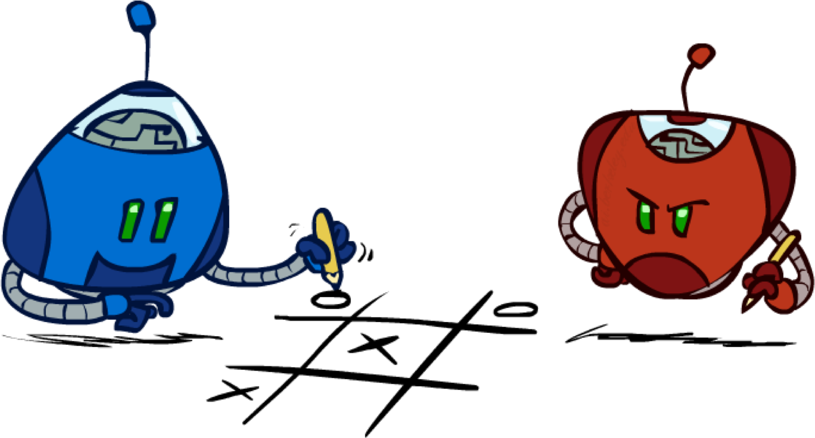
Games: Minimax and Alpha-Beta
History / Overview
Minimax for Zero-Sum Games
α-β Pruning
Finite lookahead and evaluation

Slide 16
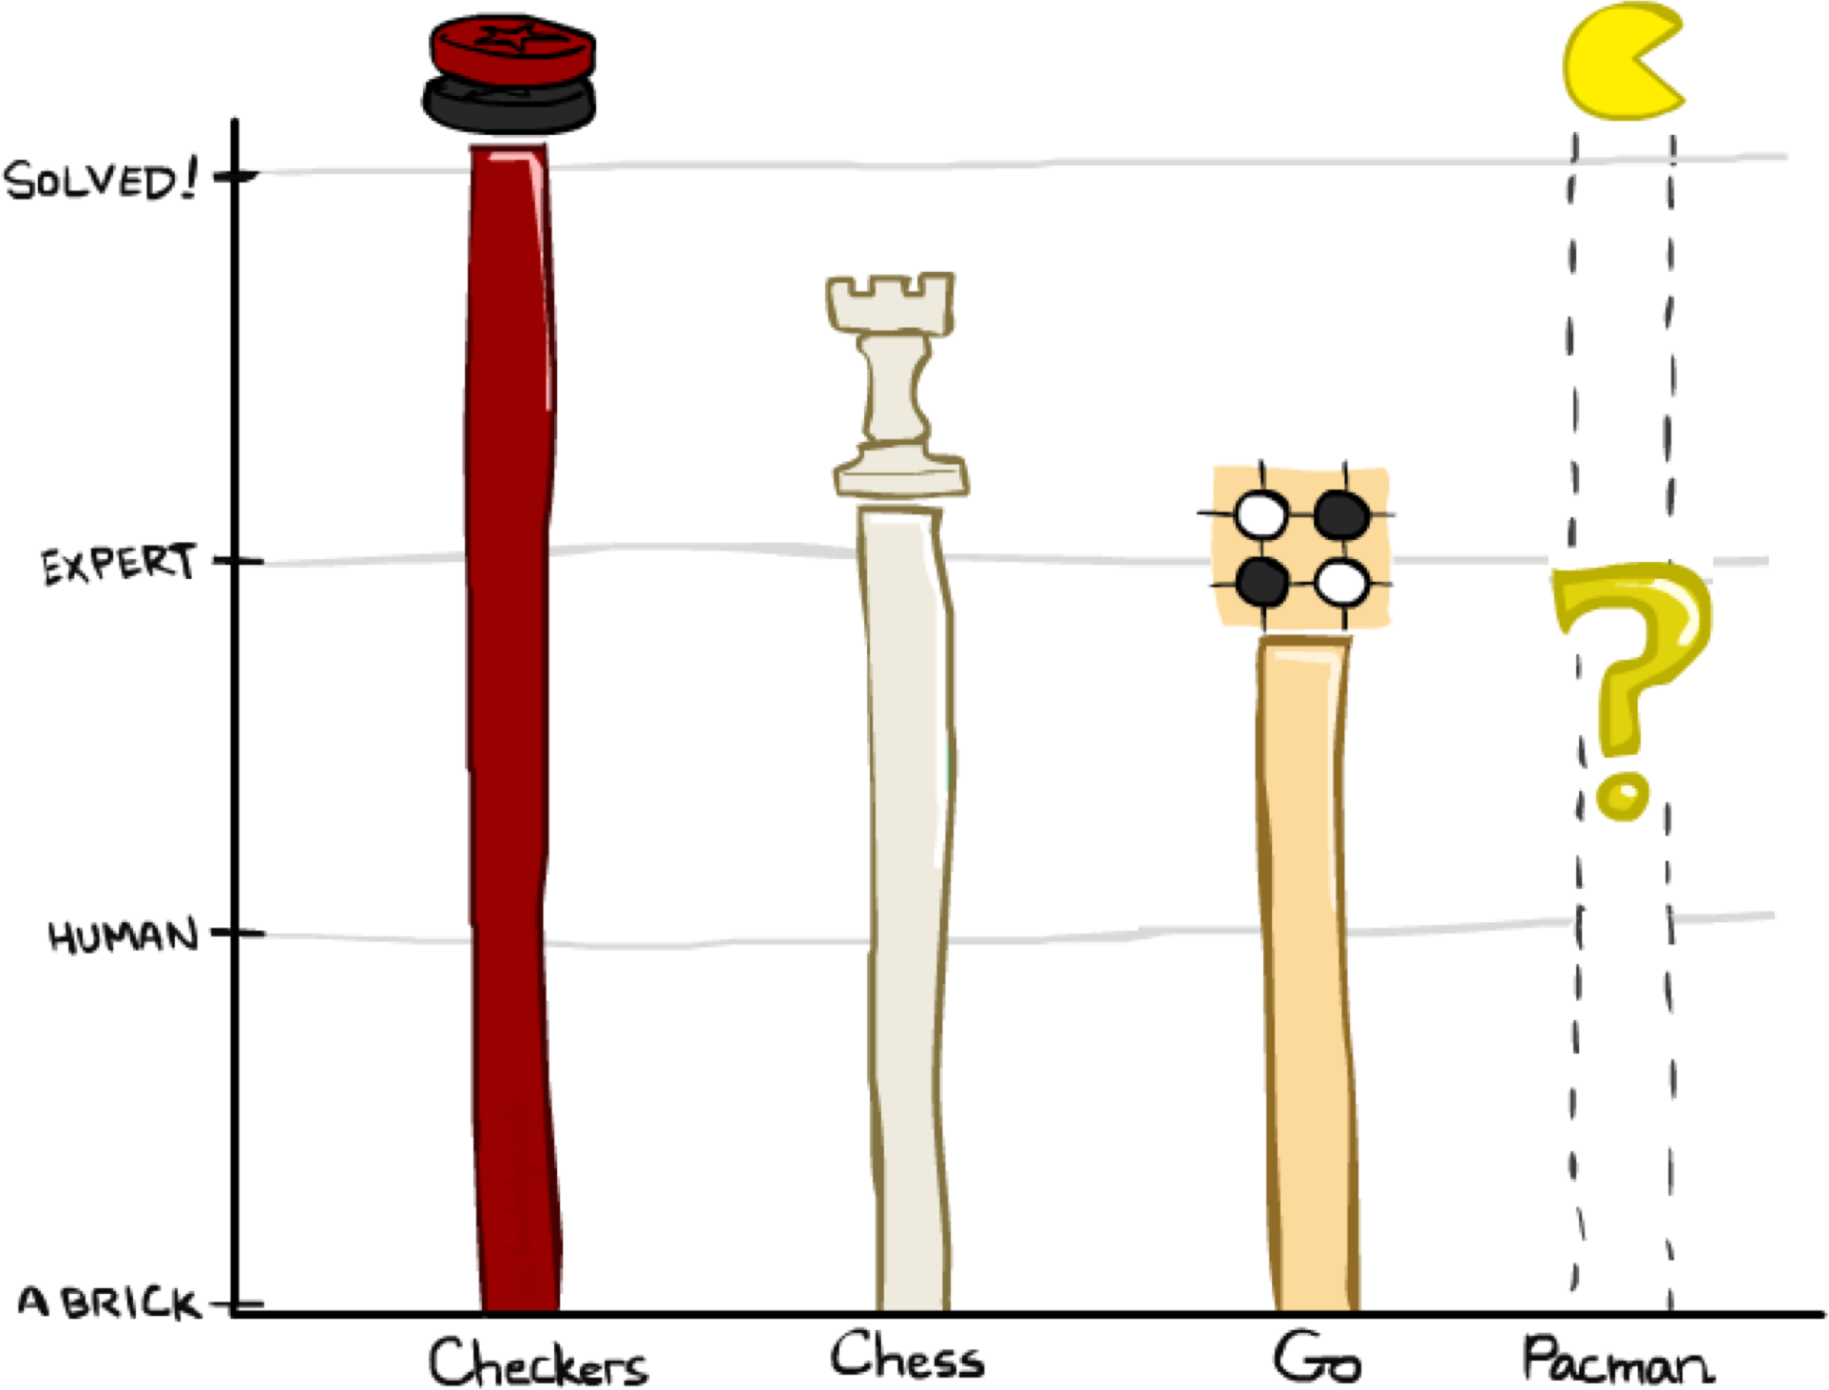
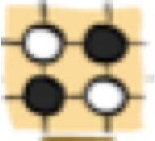

A brief history
Checkers:
1950: First computer player.
1959: Samuel’s self-taught program.
1994: First computer world champion: Chinook defeats Tinsley
2007: Checkers solved! Endgame database of 39 trillion states
Chess:
1945-1960: Zuse, Wiener, Shannon, Turing, Newell & Simon, McCarthy.
1960s onward: gradual improvement under “standard model”
1997: Deep Blue defeats human champion Garry Kasparov
2022: Stockfish rating 3541 (vs 2882 for Magnus Carlsen 2015).
Go:
1968: Zobrist’s program plays legal Go, barely (b>300!)
1968-2005: various ad hoc approaches tried, novice level
2005-2014: Monte Carlo tree search -> strong amateur
2016-2017: AlphaGo (from DeepMind) defeats human world champions. Uses deep learning + Advanced Search
2022: AlphaGo Zero now considered the top Go player in the world

Slide 17
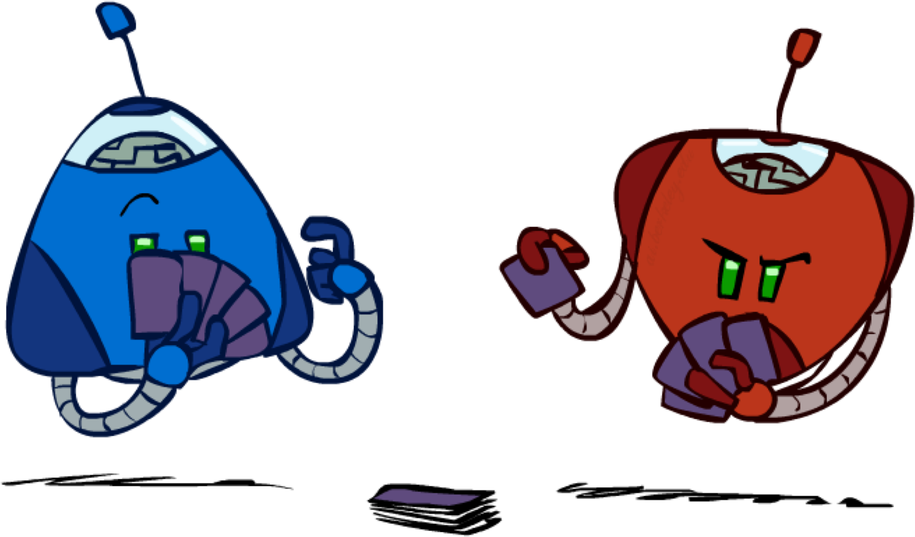
Types of Games
Game = task environment with > 1 agent
Axes:
Deterministic or stochastic?
Perfect information (fully observable)?
Two, three, or more players?
Teams or individuals?
Turn-taking or simultaneous?
Zero sum?
Want algorithms for calculating a contingent plan (a.k.a. strategy or policy) which recommends a move for every possible eventuality

Slide 18
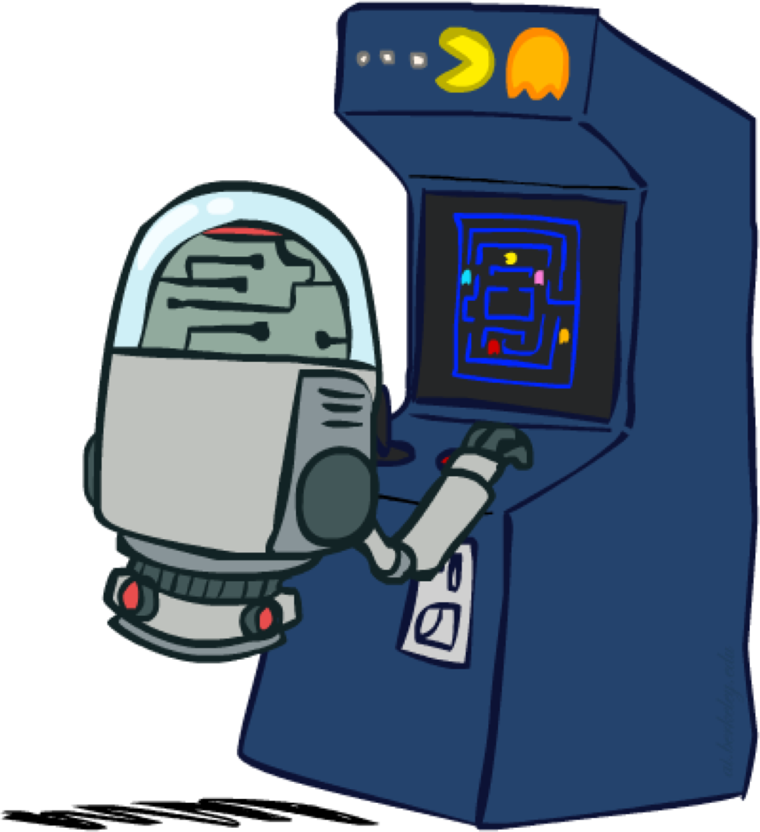
“Standard” Games
Standard games are deterministic, observable, two-player, turn-taking, zero-sum
Game formulation:
Initial state: s₀
Players: Player(s) indicates whose move it is
Actions: Actions(s) for player on move
Transition model: Result(s,a)
Terminal test: Terminal-Test(s)
Terminal values: Utility(s,p) for player p
Or just Utility(s) for player making the decision at root

Slide 19
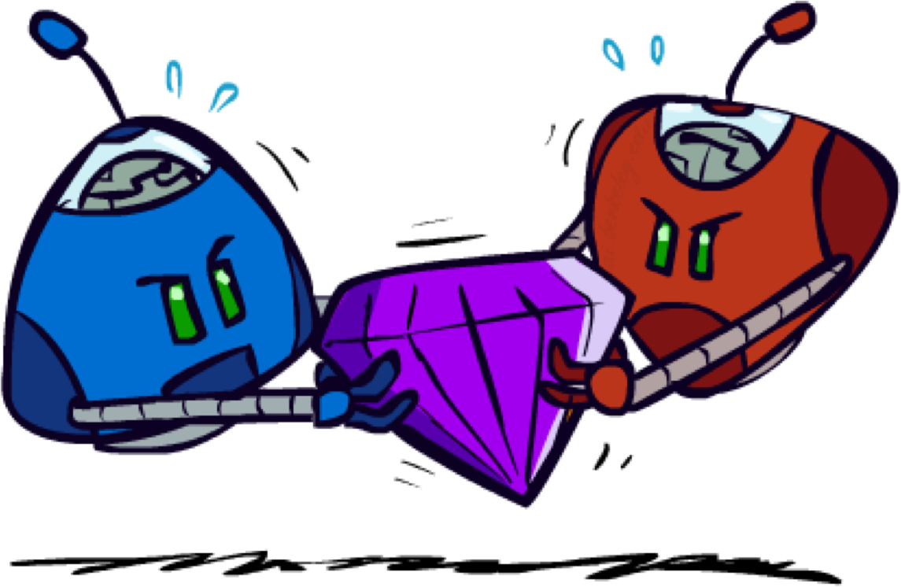
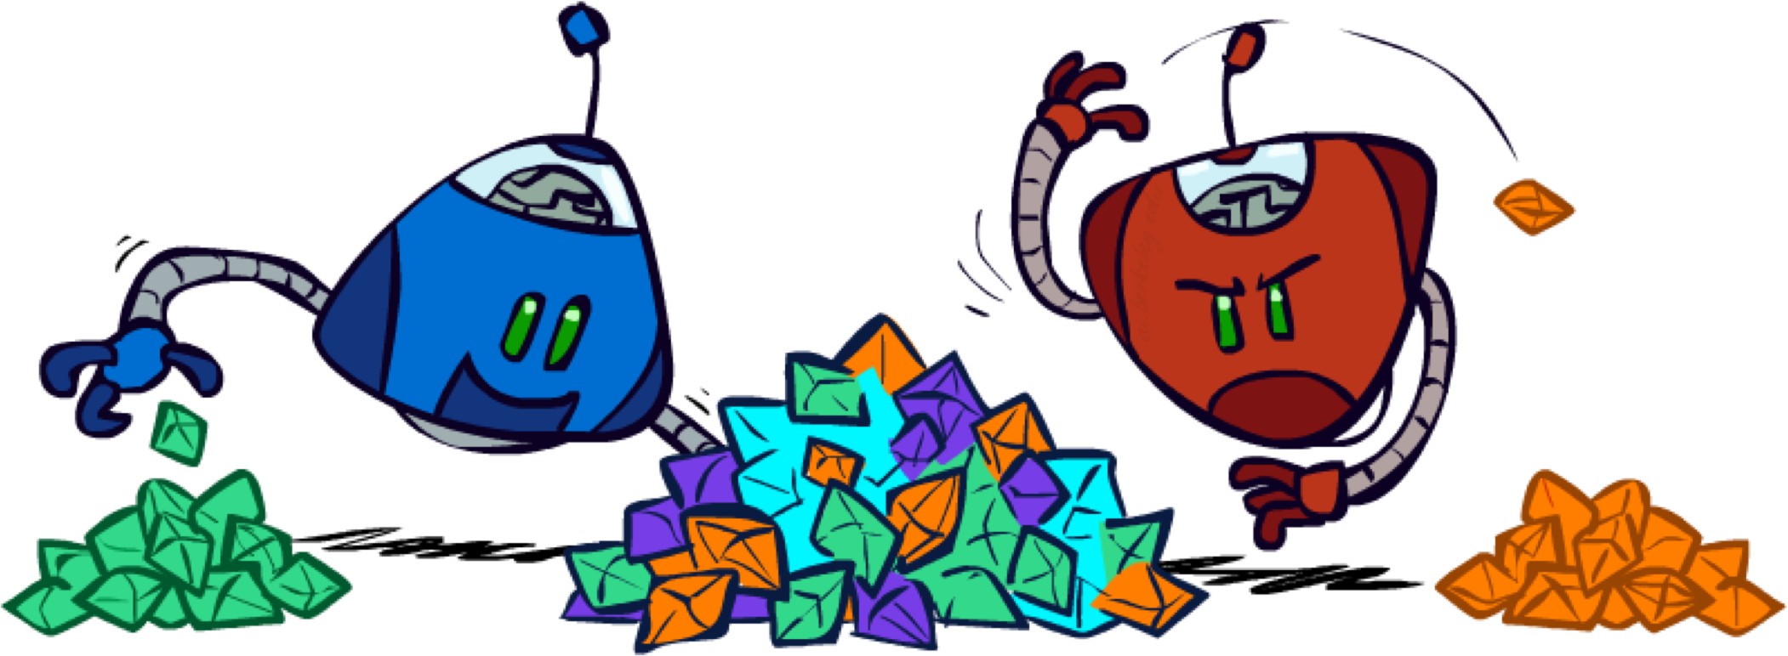

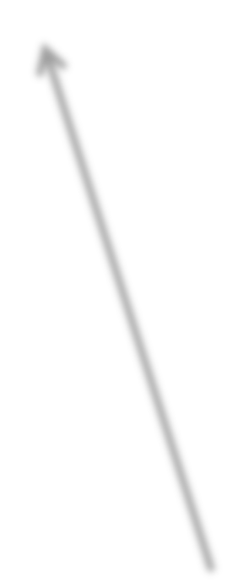
Zero-Sum Games
Zero-Sum Games
Agents have opposite utilities
Pure competition:
One maximizes, the other minimizes
General-Sum Games
Agents have independent utilities
Cooperation, indifference, competition, shifting alliances, and more are all possible
Team Games
Common payoff for all team members

Slide 20
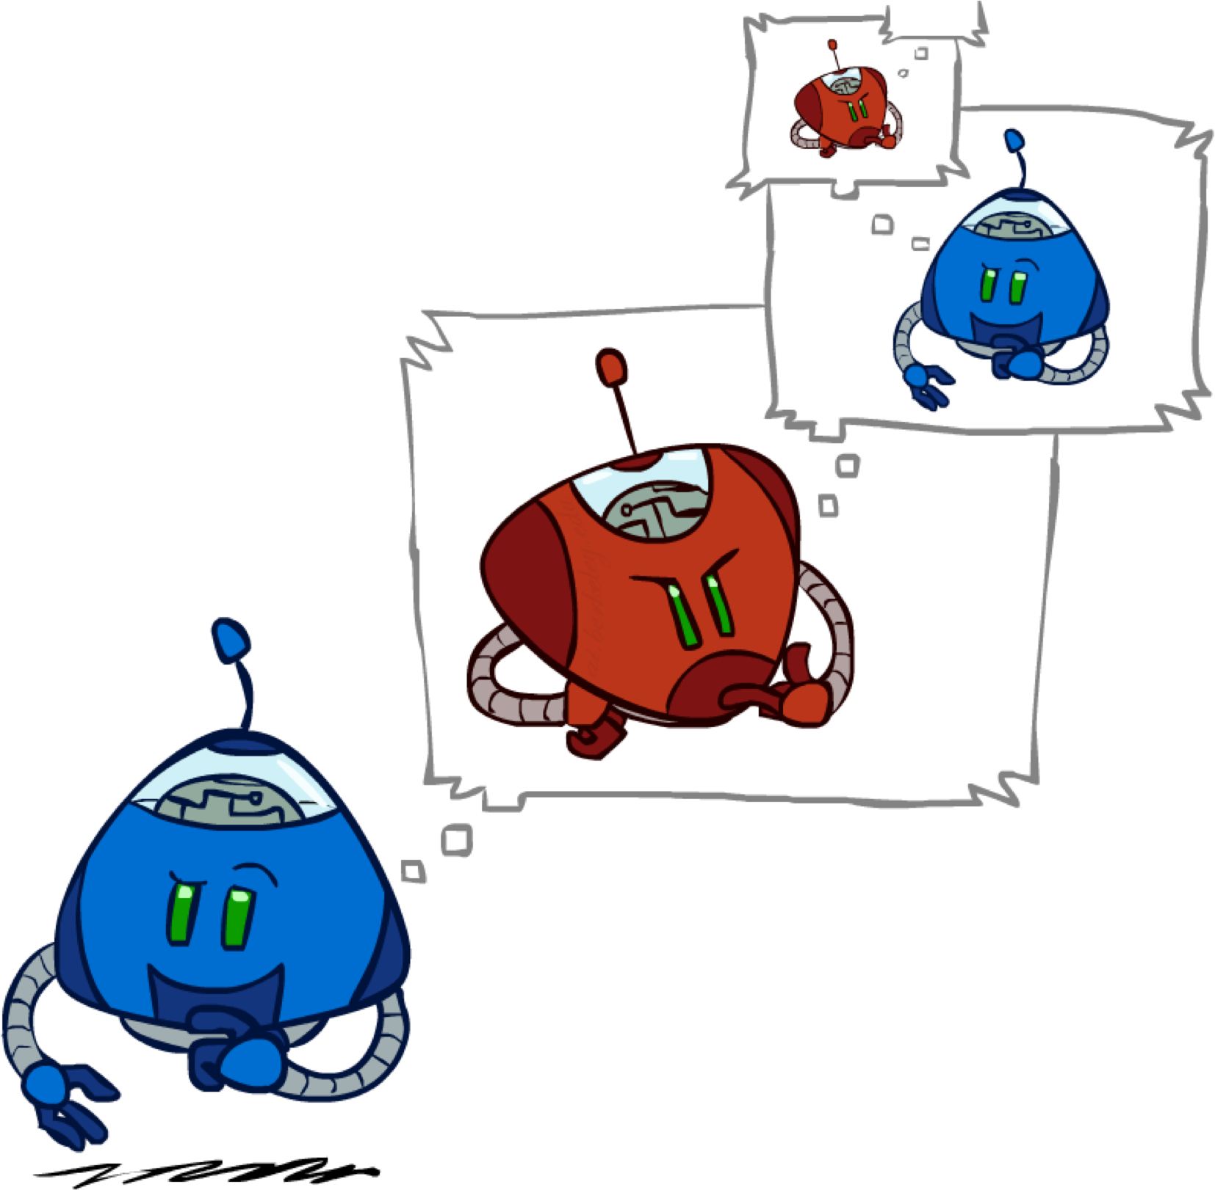
Adversarial Search

Slide 21


Single-Agent Trees
8
2 0
… 2 6
… 4 6

Slide 22
Value of a State
Value of a state: The best achievable outcome (utility) from that state
Non-Terminal States:
V(s) = max V(s’)
s’ Ε successors(s)
8
2 0
… 2 6
… 4 6
Terminal States:
V(s) = known

Slide 23


Minimax Values
MAX nodes: under Agent’s control MIN nodes: under Opponent’s control
V(s) = max V(s’) V(s) =
s’ Ε successors(s)
min V(s’)
s’ Ε successors(s)
-8
-8
-10
-8
-5
Terminal States:
V(s) = known
-10
+8

Slide 24

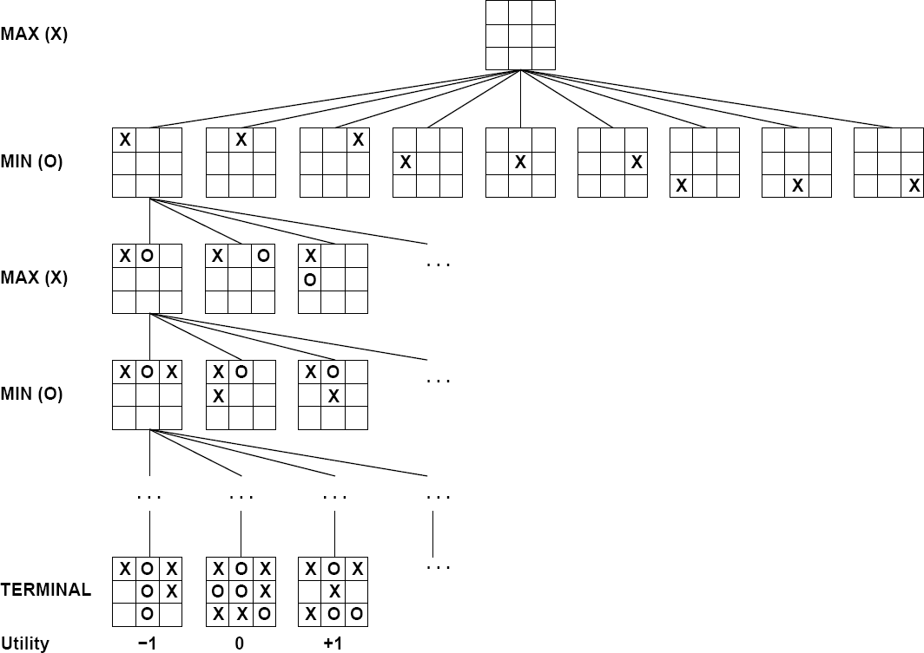

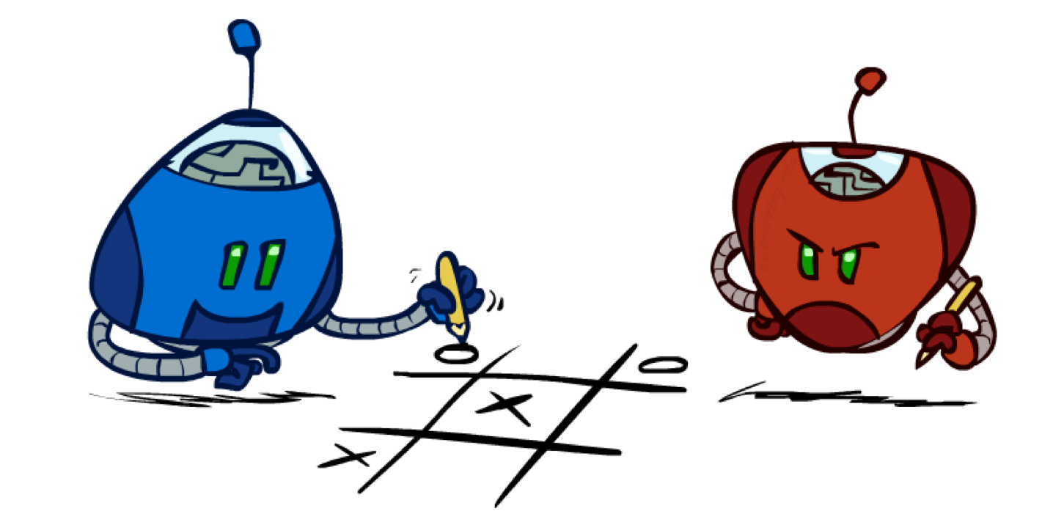

Tic-Tac-Toe Game Tree

Slide 25
Minimax algorithm
Choose action leading to state with best minimax value
Assumes all future moves will be optimal
■ => rational against a rational player
22

Slide 26
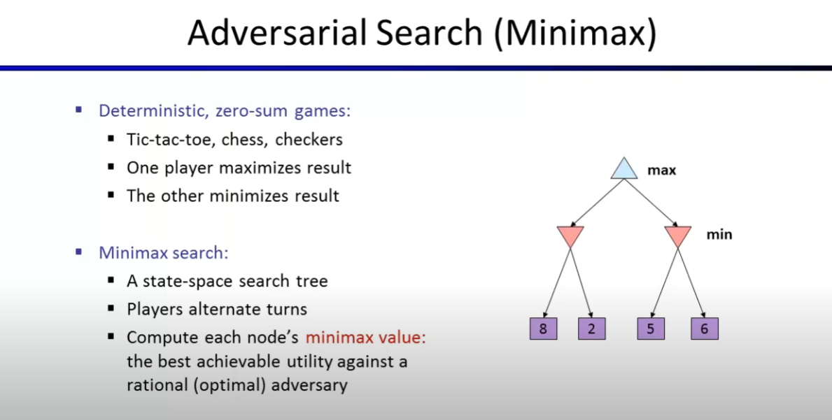

Slide 27
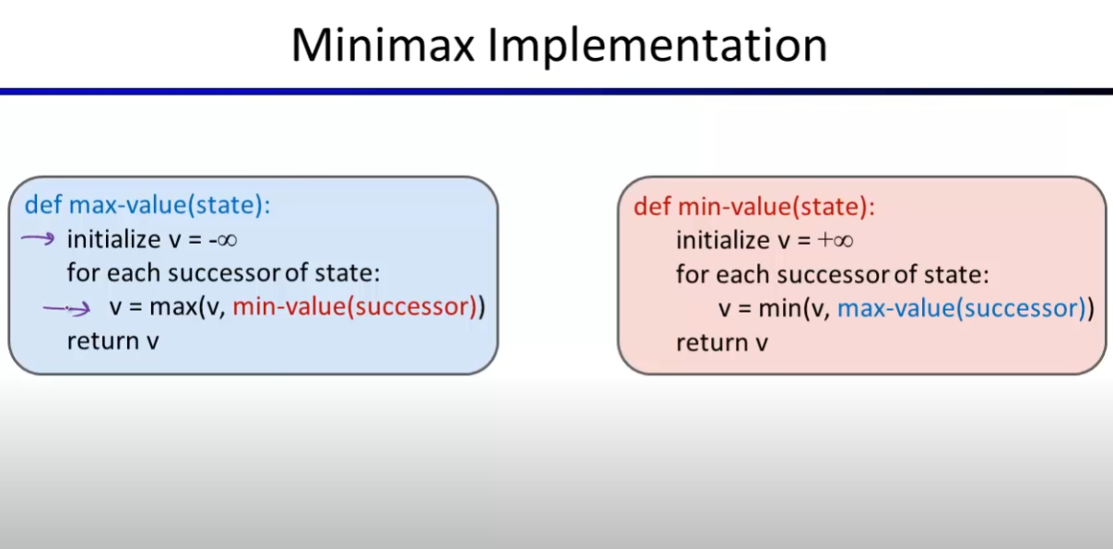

Slide 28
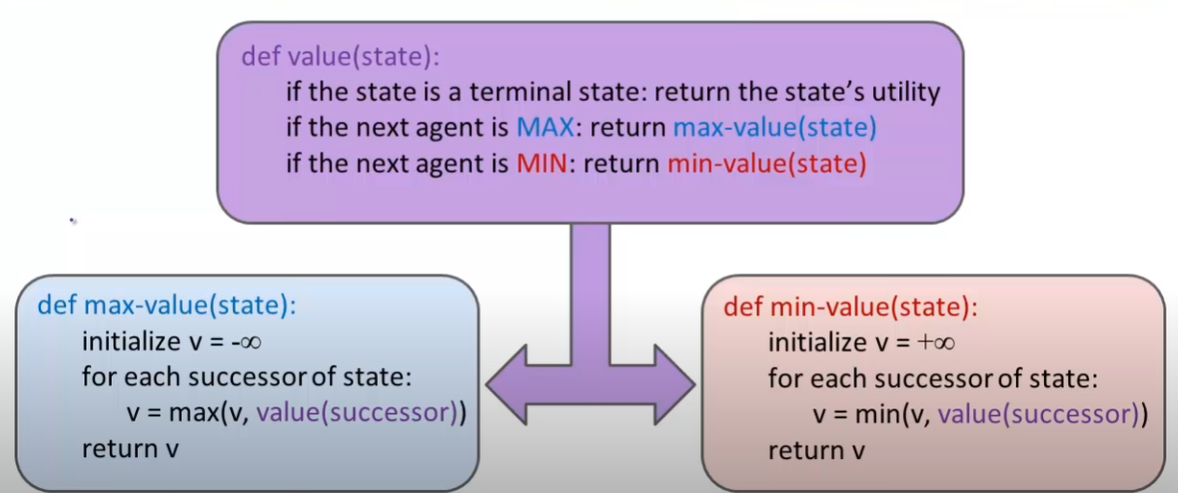
Dispatch Implementation (to avoid mutual recursion)

Slide 29

General Algorithm
function minimax-decision(s) returns an action
return the action a in Actions(s) with the highest minimax_value(Result(s,a))
function minimax_value(s) returns a value if Terminal-Test(s) then return Utility(s)
if Player(s) = MAX then return max_{a in Actions(s)} minimax_value(Result(s,a)) if Player(s) = MIN then return min_{a in Actions(s)} minimax_value(Result(s,a))

Slide 30
Minimax Example
3
3
2
2
3
12
8
2
4
6
14
5
2

Slide 31






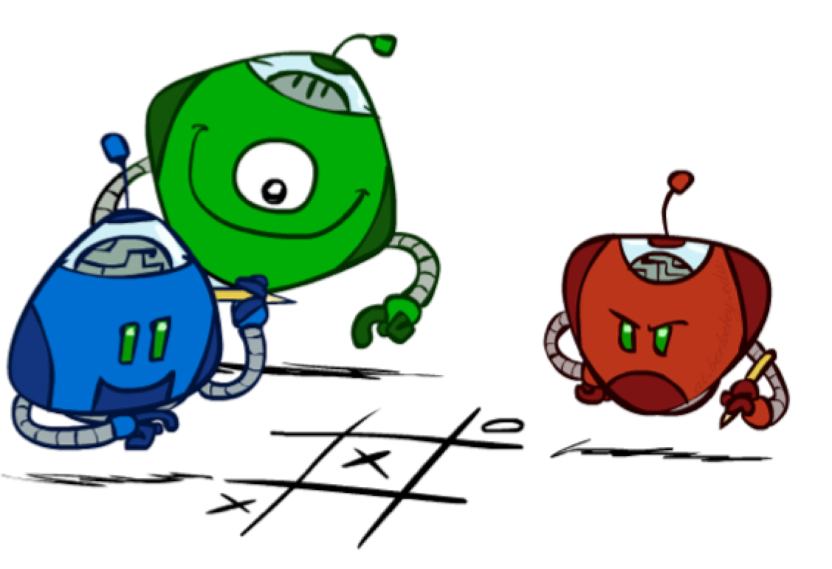


Generalized minimax
What if the game is not zero-sum, or has multiple players?
Generalization of minimax:
8,8,1
Terminals have utility tuples
Node values are also utility tuples
Each player maximizes its own component
Can give rise to cooperation and competition dynamically…
8,8,1
7,7,2
0,0,7
8,8,1
7,7,2
0,0,8
1,1,6
0,0,7
9,9,0
8,8,1
9,9,0
7,7,2
0,0,8
0,0,7

Slide 32

Minimax Efficiency
How efficient is minimax?
Just like (exhaustive) DFS
Time: O(b^{m})
Space: O(bm)
Example: For chess, b ::: 35, m ::: 100
Exact solution is completely infeasible
Humans can’t do this either, so how do we play chess?

Slide 33
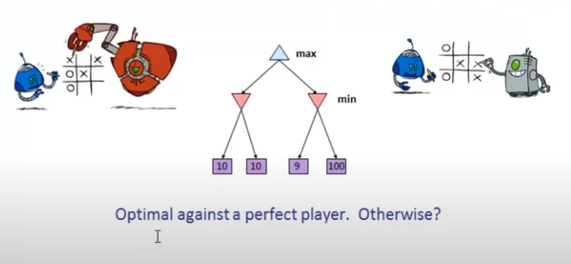
Optimal vs Sub-Optimal Players

Slide 34
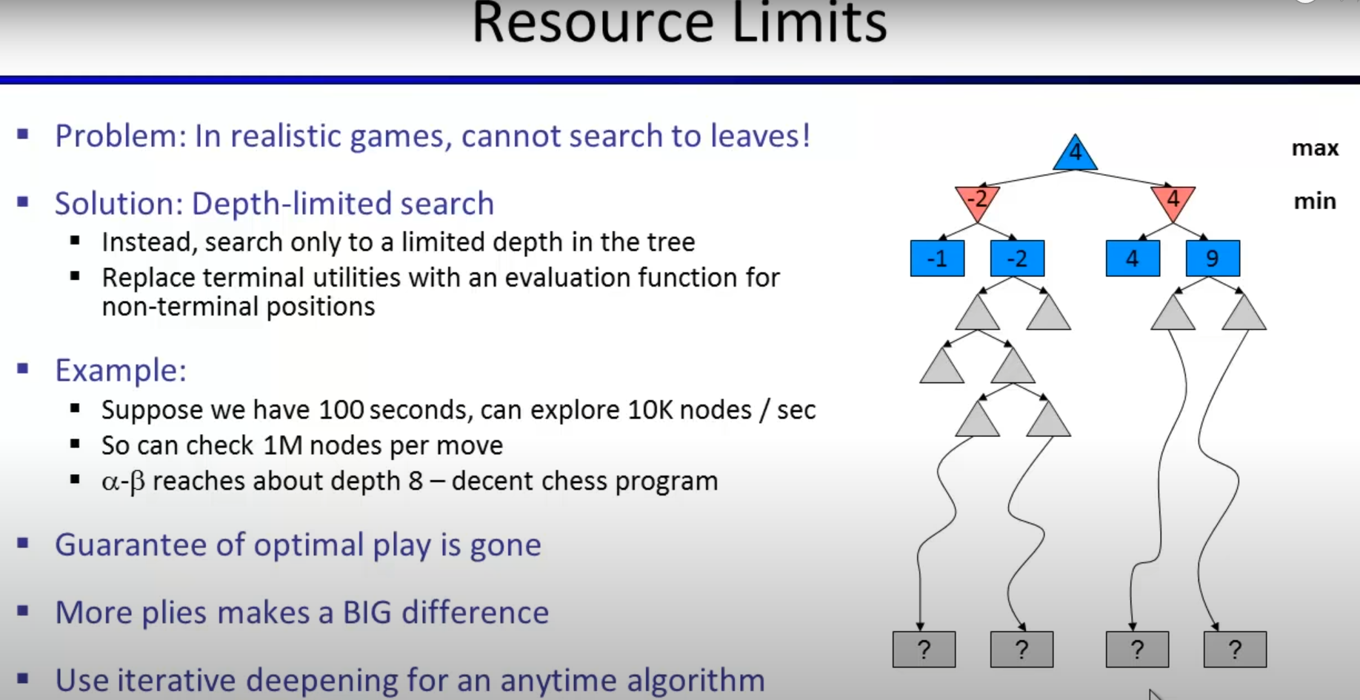

Slide 35
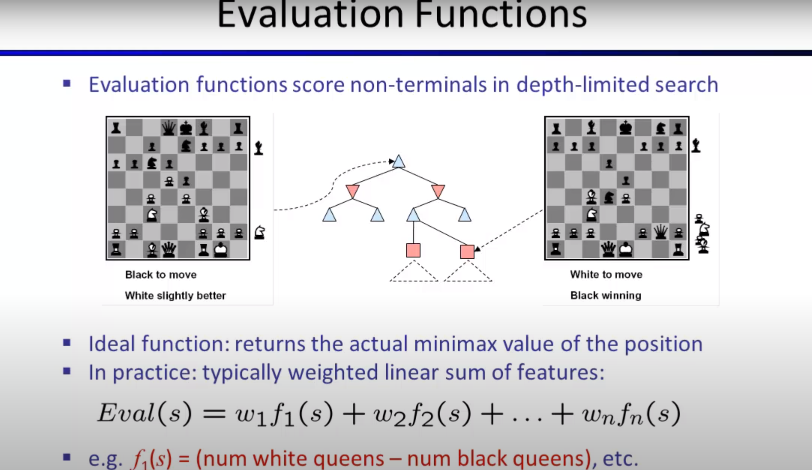

Slide 36
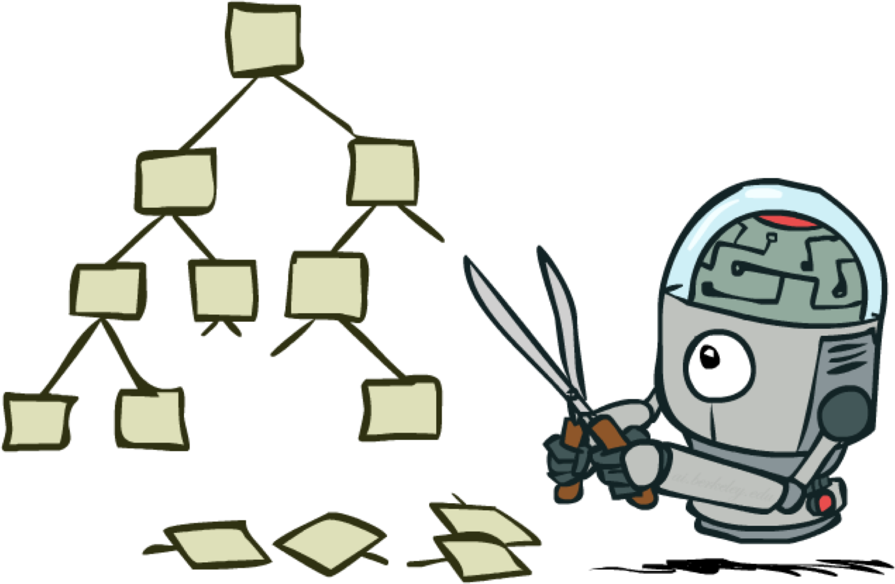
Game Tree Pruning

Slide 37

Alpha-Beta Example
α = best option so far from any MAX node on this path
3
α =3
α =3
3
3
12
8
2
14
5
2
The order of generation matters: more pruning is possible if good moves come first

Slide 38
Alpha-Beta Pruning
General case (pruning children of MIN node)
We’re computing the MIN-VALUE at some node n
We’re looping over n’s children
n’s estimate of the childrens’ min is dropping
Who cares about n’s value? MAX
Let α be the best value that MAX can get so far at any choice point along the current path from the root
If n becomes worse than α, MAX will avoid it, so we can prune n’s other children (it’s already bad enough that it won’t be played)
Pruning children of MAX node is symmetric
Let β be the best value that MIN can get so far at any choice point along the current path from the root
MAX
MIN
a
MAX
MIN
n

Slide 39
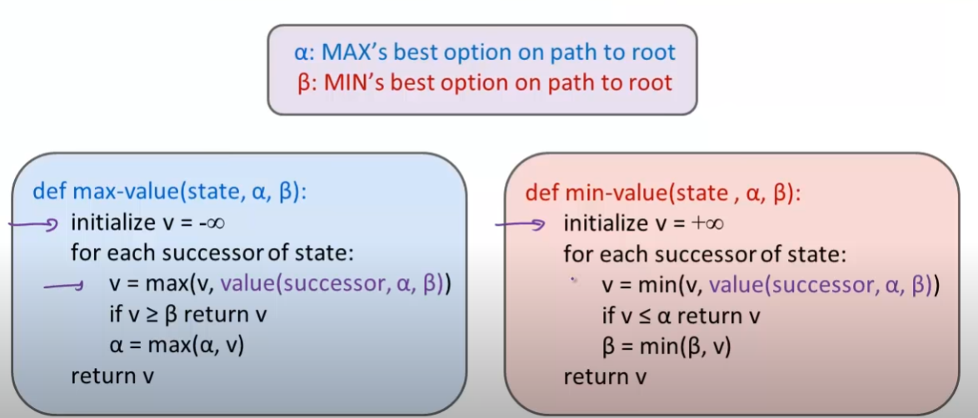
Alpha-Beta Implementation

Slide 40
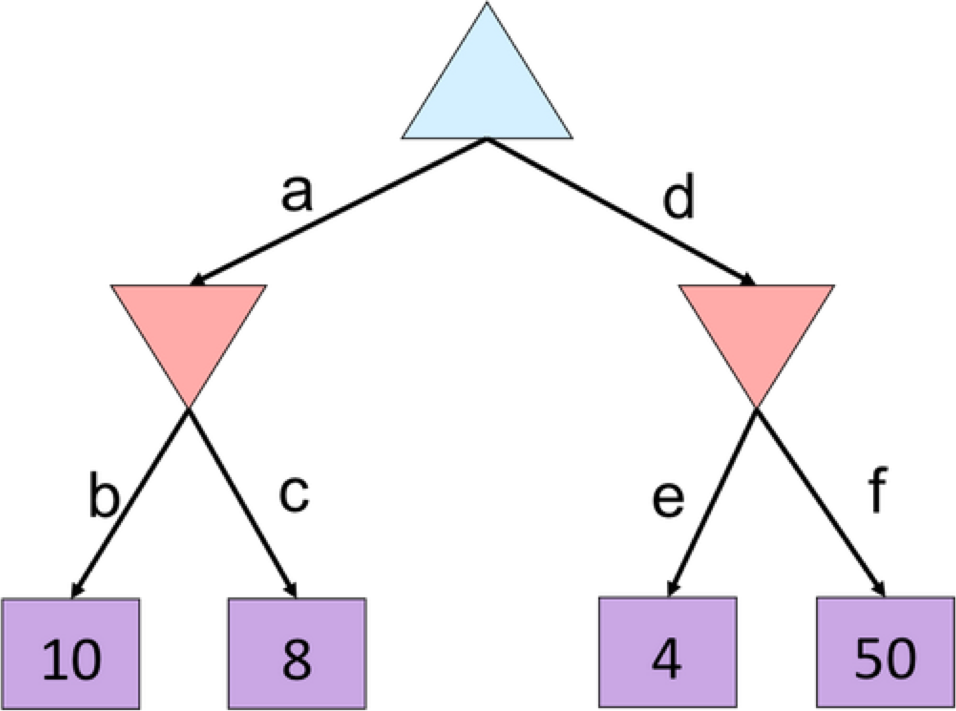
Alpha-Beta Quiz

Slide 41
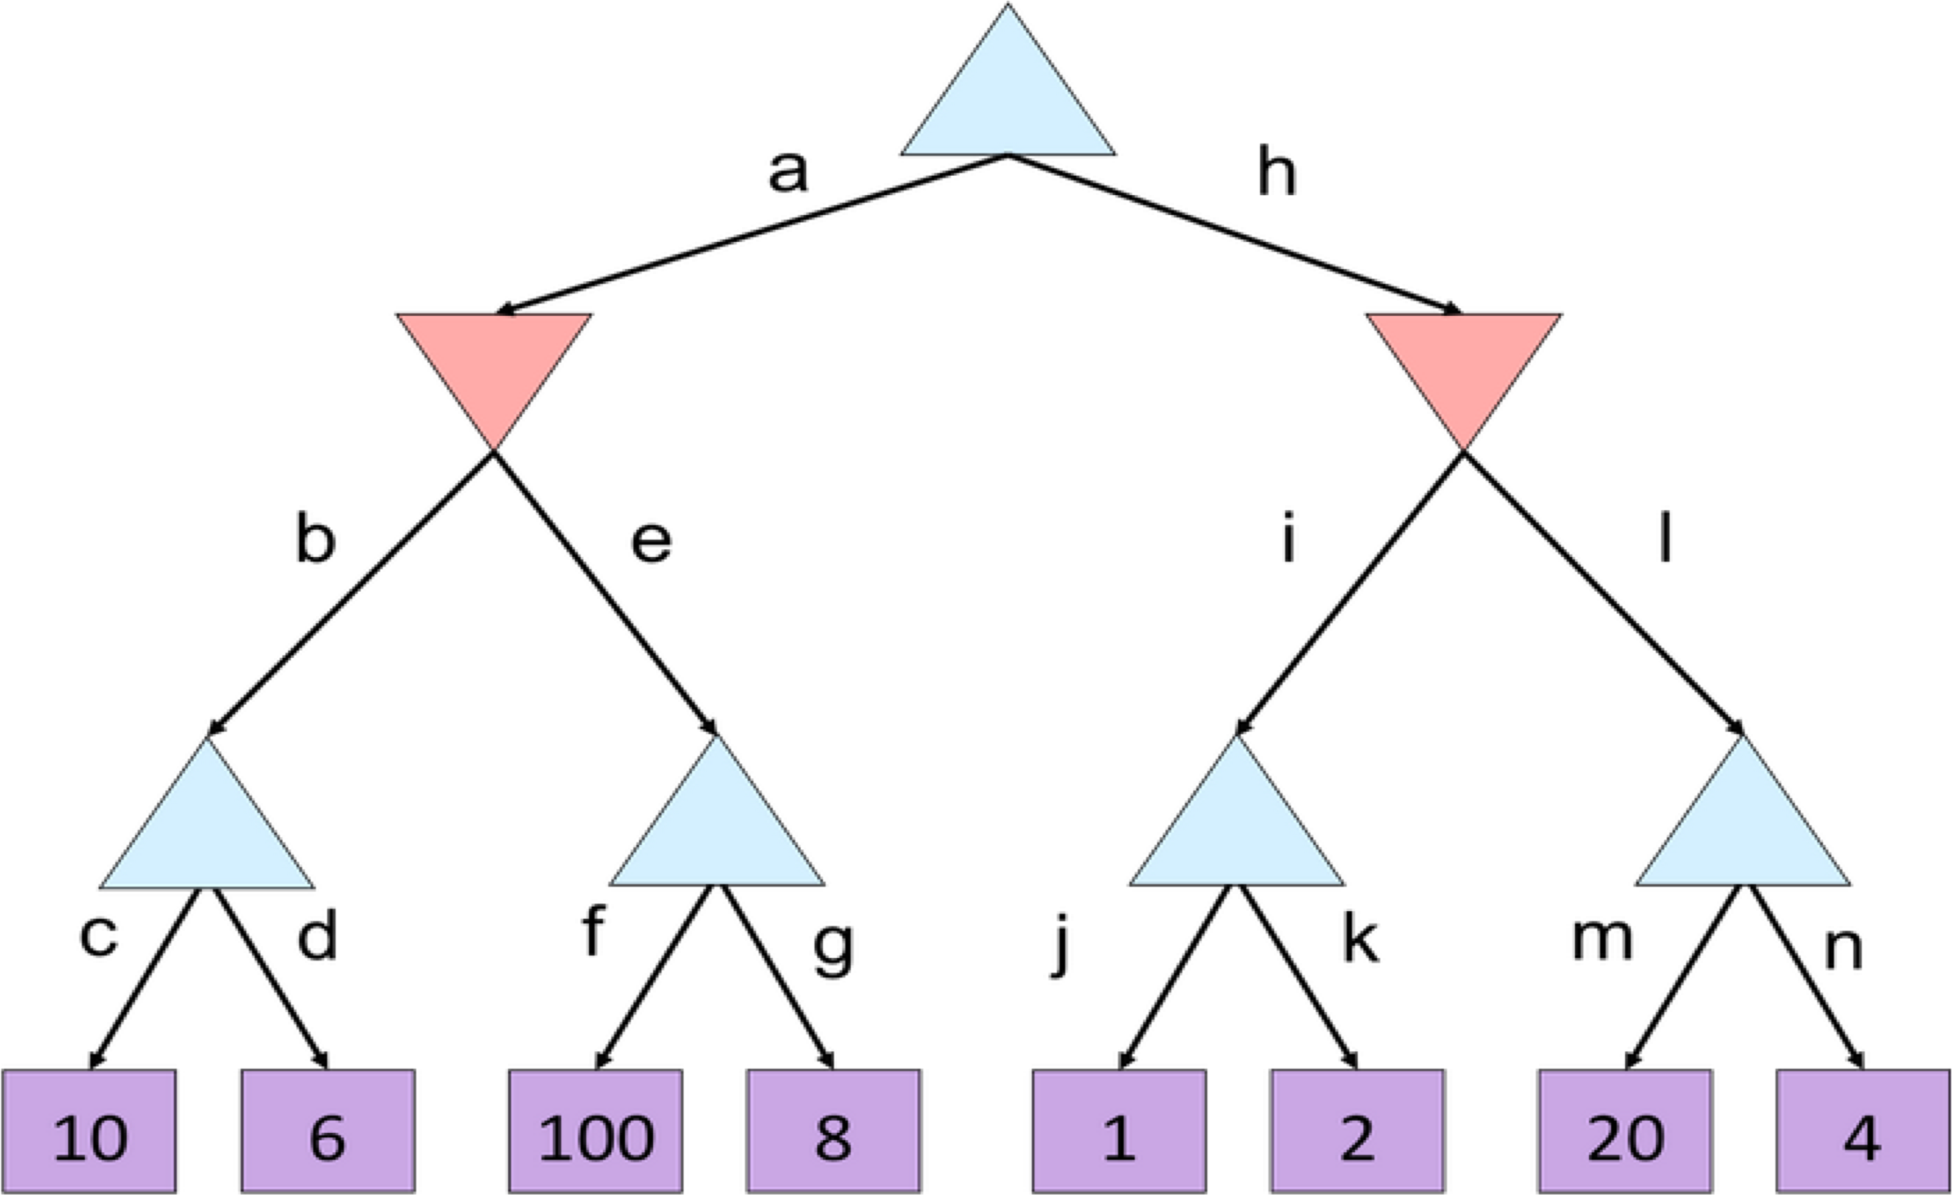
Alpha-Beta Quiz 2

Slide 42
Alpha-Beta Pruning Properties
Theorem: This pruning has no effect on minimax value computed for the root!
max
Good child ordering improves effectiveness of pruning
Iterative deepening helps with this
min
With “perfect ordering”:
Time complexity drops to O(b^{m/2})
Doubles solvable depth!
10
10
0
This is a simple example of metareasoning (reasoning about reasoning)
For chess: only 35⁵⁰ instead of 35¹⁰⁰!!

Slide 43
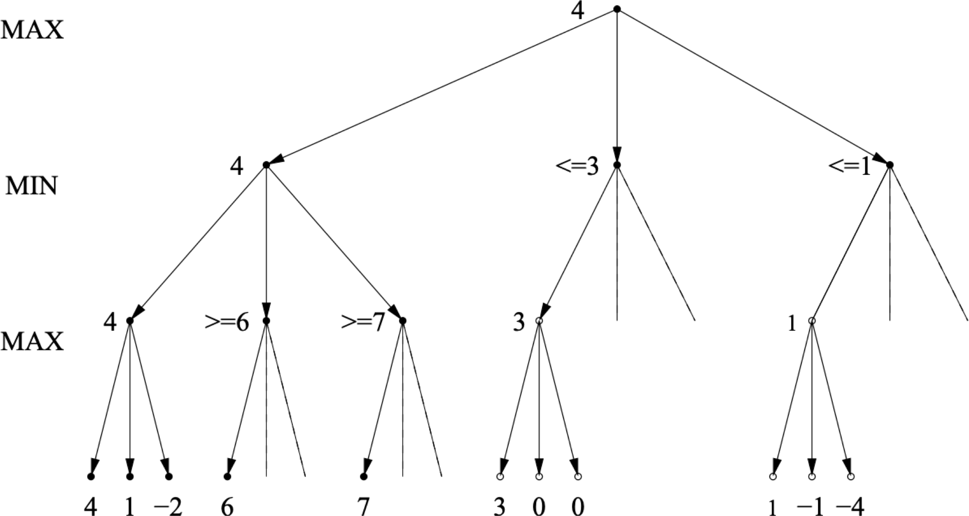
Alpha-Beta Best-Case Analysis

Slide 44
Summary
Games are decision problems with at least 2 agents
Huge variety of issues and phenomena depending on details of interactions and payoffs
For zero-sum games, optimal decisions defined by minimax
Simple extension to n-player “rotating” max with vectors of utilities
Implementable as a depth-first traversal of the game tree
Time complexity O(b^{m}), space complexity O(bm)
Alpha-beta pruning
Preserves optimal choice at the root
Alpha/beta values keep track of best obtainable values from any max/min nodes on path from root to current node
Time complexity drops to O(b^{m/2}) with ideal node ordering
Exact solution is impossible even for “small” games like chess
Truncate the depth at layer d and estimate evaluation values based on the game state.

Slide 45
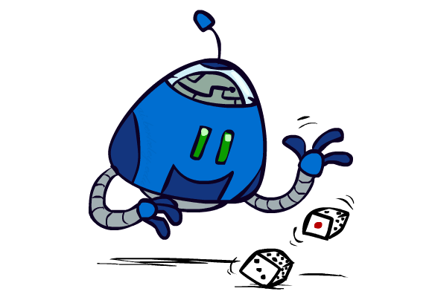
Uncertain Outcomes

Slide 46
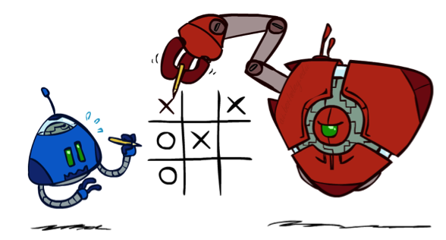

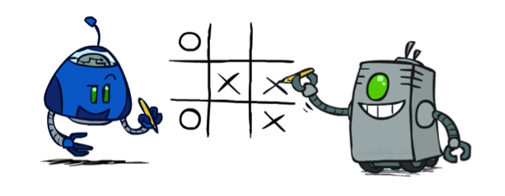
Worst-Case vs. Average Case
max
min
10
10
9
100
Idea: Uncertain outcomes controlled by chance, not an adversary!
Notes:
At least 10, or otherwise just rather dead; or just 100, or otherwise rather dead; that’s yet something different than minimax or expectimax

Slide 47
Expectimax Search
How can the result of an action will be uncertain?
Explicit randomness: rolling dice
Unpredictable opponents: the other player respond randomly
Actions may fail: when moving a robot, wheels might slip
Values should now reflect average-case (expectimax) outcomes, not worst-case (minimax) outcomes
Expectimax search: compute the average score under optimal play
Max nodes as in minimax search
Chance nodes are like min nodes but the outcome is uncertain
Calculate their expected utilities
I.e. take weighted average (expectation) of children
Later, we’ll learn how to formalize the underlying uncertain-result problems as Markov Decision Processes
max
chance
10
10
4
10
5
9
7
100

